Slide 1
Image Processing using Transfer Learning With Neo4j
By-
Nayan Verma
17U03026

Slide 2
Introduction
This project uses a trained model named “Mobilenet” , extracts it till last layer(with the help of ml5.js library) and then the model is trained with a set of images that we provide , this method is knows as transfer learning(feature-representation-transfer) . The images used to train the model are stored in the hard drive , there location and label associated with it is stored in the nosql database software named Neo4j with the type of image captured. I have also included node.js which allows socketing.

Slide 3
Node.js
p5.js
ml5.js
Logits
Probability ,
Label
Softmax
Mobilenet
KNN-Classification
Notes:
ml5.js

Slide 4
Existing Problem and Gap in recent Model
The only method provided by ml5 library to retain the data of the trained model is to download a JSON file the load it the next time you run the program.
In this project the images get stored , Neo4j stores where the image is stored and the labels associated with it .
I have a data set that I can use to train other models
If program faults in between , data is not lost
I can delete /remove unnecessary task domain.
Why Neo4j :-
Schema-free and schema-optional
Index-free adjacency shortens read time and gets better as data grows
Flexibility
Compressed storage
Triggers (not used)

Slide 5
Methodology
The web page turns the web cam on , starts loading image to the page , the user is given option to add the image to train the model , the user designs the label and the category it falls in i.e. person , animal or other (The categories can be increased). Every time the user adds a image, the image gets saved , Neo4j hold the location of image , its label and creates a relationship to the node it is related to. The Ml5.js library assists in extracting the features of a trained model named “Mobilenet”. The feature extracter object has a function infer() that return a logits i.e. “sematic fingerprint” of the image .

Slide 6
These logits are send to the KNN-Classifier object with the label of the image using addExample function . The P5.js library provides a draw function that loops for ever in which a knn classification function runs, it takes the image from webcam returns the label it predicts for the object and using P5.js the label is displayed on the video.
The value of K is set to default that is 3.
Inductive Transfer Learning setting and Feature-representation-transfer approach.

Slide 7
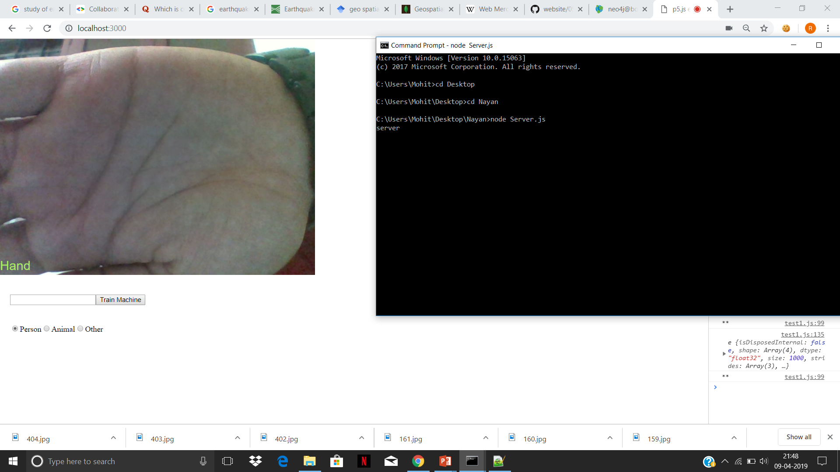
ScreenShots

Slide 8
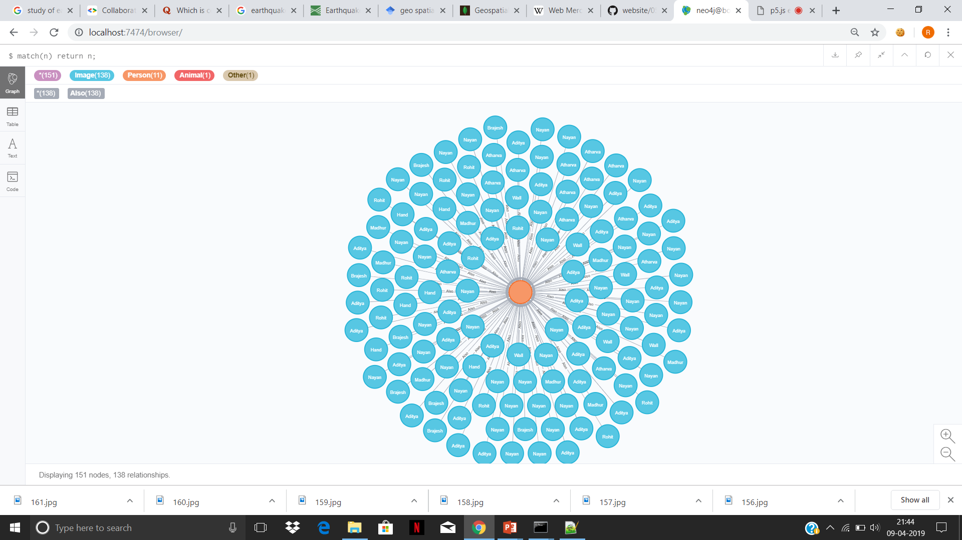
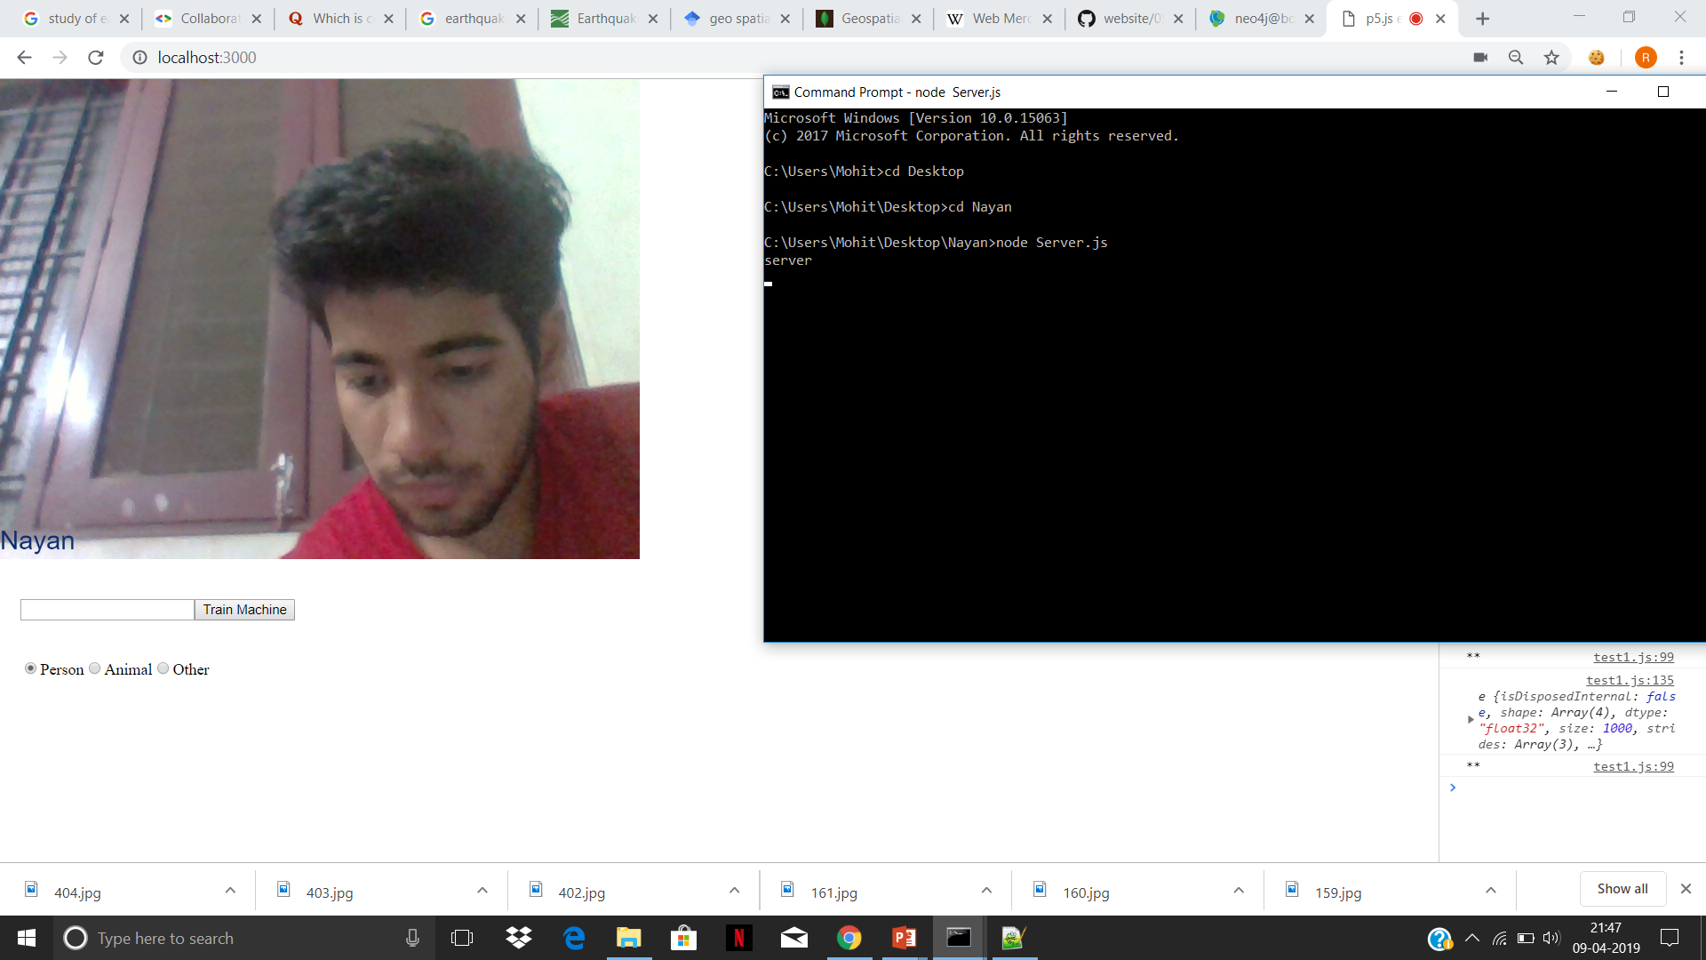

Slide 9
Conclusion
This project provides an alternative to store data of a teachable machine which can be used by other teachable machine , images are classified using knn-classificaton method on the features extracted from Mobilenet.

Slide 10
References
https://neo4j.com/docs/operations-manual/
https://neo4j.com/docs/cypher-manual/
https://medium.com/neo4j/streaming-graph-loading-with-neo4j-and-apoc-triggers-188ed4dd40d5
https://neo4j-contrib.github.io/neo4j-apoc-procedures/
https://machinelearningmastery.com/transfer-learning-for-deep-learning/
https://p5js.org/reference/
https://ml5js.org/docs/
https://observablehq.com/@nsthorat/how-to-build-a-teachable-machine-with-tensorflow-js/safe
https://www.youtube.com/user/shiffman

